Slide 1
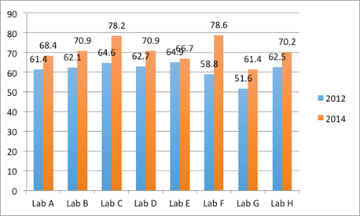
Application of Laboratory Mapping Tools in Improving Laboratory Capacity in Indonesia
Boethdy Angkasa¹, Purnama Martha Oktavia Simanjuntak¹, Audi T Harsono², Nining Hartaningsih², Syafrison Idris¹, Fadjar Sumping Tjatur Rasa¹, Filip Claes³, James McGrane², Dhony Kartika Nugroho¹
1Directorate General of Livestock and Animal Health Services, Ministry of Agriculture, Republic of Indonesia
2Food and Agriculture Organization of the United Nation, Emergency Centre for Transboundary Animal Diseases, Jakarta, Indonesia
3FAO Regional Office for Asia and the Pacific, Bangkok, Thailand.
*Corresponding Author: p2hditkeswan@gmail.com
Introduction
The FAO Laboratory mapping tool (LMT) was first introduced in 2012 as an assessment tool to determine the infrastructure capacity and biosafety capability of Indonesian diagnostic laboratories. A second assessment using the same LMT version (ver.20120524.1) was conducted in 2014. Both of these assessments were carried out by international assessors in 10 animal health laboratories: eight Disease Investigation Centres, a veterinary biologicals production facility (Pusvetma) and the National Veterinary Drug Assay Laboratory (BBPMSOH). The findings of these assessments were used to establish a national animal health laboratory infrastructure and capacity baseline; outputs were also used to improve the functionality of the mapping tool.
Figure 2. Comparison of LMT results form 2012, 2017, and 2019 in one of the assessed lab
Materials and methods
Overall, the LMT has proved an extremely useful tool to understand the strengths and weaknesses of diagnostic laboratories and to plan improved laboratory diagnostic testing capacity. The LMT-Safety is useful for providing biosafety and biosecurity assessments and recommendations to improve laboratory safety, prevent the escape of biological pathogens and ensure the health and safety of laboratory staff. Application of the LMT and the presentation of well-founded recommendations to laboratory managers (once accepted) provides a basis for action to improve laboratory infrastructure, diagnostic procedures and staff safety.
Following these initial trainings, the FAO Regional Office conducted LMT and LMT-S (laboratory biosafety module) application training in Bangkok, in 2016. LMT-S is a variant of the basic or core LMT focused on laboratory biosafety and biosecurity. This training was attended by participants from Asian countries, including four from Indonesia. With support from these new trainers and FAO, the Directorate General Livestock and Animal Health Services (DGLAHS) conducted their own LMT application training for the same 10 animal health laboratories and additional labs including human health, university and provincial laboratories. After the 2017 Indonesia training, laboratory self-assessments were conducted by participants at 8 of the 10 DGLAHS laboratories.
It is recommended that all DGLAHS animal health laboratories adopt the core LMT and LMT-Safety as standard tools to regularly assess laboratory capacity, ensure compliance with diagnostic SOPs, and quality assurance, and adherence to international (ISO) laboratory health and safety standards. Laboratory networking should be further developed to promote adoption and sharing of best laboratory practices. LMT assessment results should be presented to animal health decision makers to lobby for increased investment in the laboratory system to support animal health and livestock development in Indonesia.
Results and discussion
References
[1] Becker RA, Janus ER, White RD, Kruszewski FH, et al. 2009. Environ Health Perspect. Nov; 117(11): A482–A483.
Acknowledgements
The work reported in this publication was supported by USAID with the technical collaboration of FAO ECTAD Indonesia, the FAO Regional Office for Asia and the Pacific and the Directorate General of Livestock and Animal Health Services, Ministry of Agriculture, Indonesia.
Figure 1. Comparison of 2012, and 2014 overall FAO LMT core scores for DIC’s laboratories

